Slide 1
THE OPEN COMMUNITY ENGAGEMENT PROCESS
Stan Ahalt, PhD
Renaissance Computing Institute
Computer Science
University of North Carolina at Chapel Hill
Notes:
Stan you have 18 minutes total

Slide 2
Working toward empowering scientists with better software to support their research and enable them to answer grand challenge research questions.
Notes:
Today’s scientific research requires software.
Yet commercial packages may be insufficient. For example,
Current software may not be able to process the kinds of data water/ecological/environmental scientists work with quickly and easily
In our highly dynamic environment, software may be insufficient at collecting and aggregating data at the speeds and intervals needed
Interfaces may be overly complex
Models may be confusing, outdated, or simply not implemented well
So scientists have had to resort to creating their own software; yet most busy scientists do not have the time or funding to make it sustainable and scalable to other research questions and data sets.
With funding from the National Science Foundation’s Scientific Software Innovation Institutes (S2I2) program, WSSI is working toward empowering scientists with better software to conduct research and take their research to the next level—software that is sustainable, scalable, test-driven, etc.
[1 min]

Slide 3
BOUNDARY OBJECTS
“Boundary objects are objects which are both plastic enough to adapt to local needs and constraints of the several parties employing them, yet robust enough to maintain a common identity across sites…They may be abstract or concrete. They have different meanings in different social worlds but their structure is common enough to more than one world to make them recognizable, a means of translation. The creation and management of boundary objects is key in developing and maintaining coherence across intersecting social worlds.”
Star, S. & Griesemer, J. (1989). Institutional Ecology, 'Translations' and Boundary Objects: Amateurs and Professionals in Berkeley's Museum of Vertebrate Zoology, 1907-39. Social Studies of Science, 19(3): 387–420.
Notes:
Boundary objects are INFORMATION objects (i.e., representations of information) that are flexible/plastic in the way that, although they may mean different things to different people, there is something translational about them that allows different people to come together and understand a common idea because of them. Examples include:

Slide 4
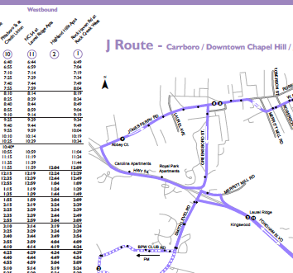
BOUNDARY OBJECTS: BUS SCHEDULE
To a bus driver it signifies the parameters of their job.
To a passenger it signifies a way to get around.
To the transit manager it represents a way to communicate about services offered.
Even though all use it for different reasons, all can use it as a common point of reference for discussions of transportation around town.
Notes:
Example 1: something you are all probably familiar with – a bus schedule
A bus schedule (to bus drivers it signifies parameters of their job, to passengers it means a way to get around, to the transit service manager it means a way to communicate about services to the public – yet to all it is a representation of ideas held in common… transportation)

Slide 5
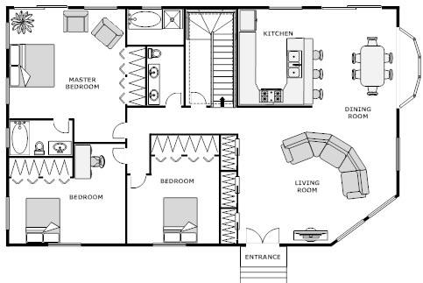
BOUNDARY OBJECTS: FLOOR PLAN
To the architect it is a design and manifestation of work and ideas.
To a home owner it may mean safety, family, comfort.
For both stakeholders, it provides an artifact around which they can have a conversation. They can discuss needs, expectations, ideas, desires, future goals.
Notes:
Example 2: an architectural diagram
an architectural diagram of a house (to the architect it is a design and a manifestation of work and ideas, to a home owner it may mean safety and family and relaxation)

Slide 6
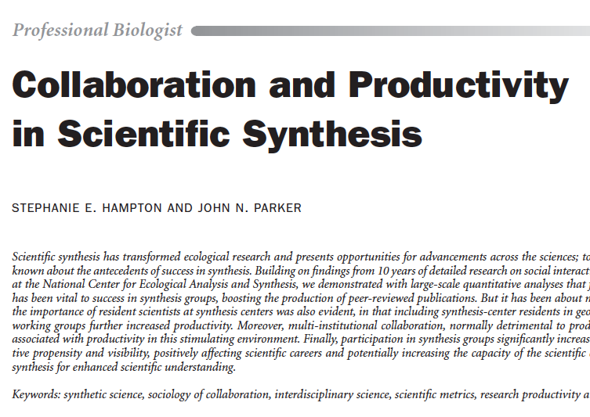
BOUNDARY OBJECTS: JOURNAL PAPER
To the authors, it signifies conclusions they have drawn as a result of scientific work.
To the reader, it signifies new knowledge gained.
To the journal editor, it signifies work products to be communicated as a part of the mission of the journal.
For all, it is a form of knowledge about collaboration, productivity, and synthesis – a resource for scientists.
Notes:
Example 3: a journal article
To the authors, it signifies conclusions they have drawn as a result of scientific work.
To the reader, it signifies new knowledge gained.
To the journal editor, it signifies work products to be communicated as a part of the mission of the journal.
For all, it is a form of knowledge about collaboration, productivity, and synthesis – a resource for scientists.

Slide 7

BOUNDARY OBJECTS: DATA SET
To the scientist, it signifies a font of possibilities for new knowledge, a way to test a hypothesis or answer a research question, a wealth of publication possibilities.
To the curator, it signifies a piece of a digital collection that would be more easily found if it contained metadata. It may also signal concerns about use in the future—will the file format be accessible 50 years from now.
To both, it is a form of intellectual property around which they can discuss data management concerns, annotation, metadata, and search/sharing/use.
Notes:
Example 4: a data set
To the scientist, it signifies a font of possibilities for new knowledge, a way to test a hypothesis or answer a research question, a wealth of publication possibilities.
To the curator, it signifies a piece of a digital collection that would be more easily found if it contained metadata. It may also signal concerns about use in the future—will the file format be accessible 50 years from now.
To both, it is a form of intellectual property around which they can discuss data management concerns, annotation, metadata, and search/sharing/use.

Slide 8
BOUNDARY OBJECTS: SOFTWARE
To the developer it represents a series of command written in code that allow users to perform certain work functions.
To the user it represents possibilities for achieving work goals.
To the the open source community in the case of R, it represents a community owned tool that each can use, improve on, peer review, and contribute to.
To all, it is a rich information processing tool that allows the open source community to perform statistical analysis.
All can talk about the libraries, the code itself, the statistical tests it can perform, scientific results, improvements to the code, etc.
Notes:
Example 5: software
To the developer it represents a series of command written in code that allow users to perform certain work functions.
To the user it represents possibilities for achieving work goals.
To the the open source community in the case of R, it represents a community owned tool that each can use, improve on, peer review, and contribute to.
To all, it is a rich information processing tool that allows the open source community to perform statistical analysis.
All can talk about the libraries, the code itself, the statistical tests it can perform, scientific results, improvements to the code, etc.

Slide 9

BOUNDARY OBJECTS
Possess “interpretive flexibility” where the use and interpretation of the object are different for different groups.
Yet provide a common point of reference which allows different groups to work together.
Thus, they allow different stakeholders to translate:
Vocabulary and discourse
Practices and expertise
Needs and expectations
Notes:
Interpretative flexibility – The bus driver, passenger, and transit manager all use and view the bus schedule differently. Users and coders of R may use it differently depending upon needs. They may use it for different projects and studies.
Common point of reference – Yet all stakeholders share a common point of reference to do the work/play they need to do. The boundary object serves as a communication device.
Software example:
Interpretative flexibility – the developer and user interact with the software for different reasons and view the purpose of those interactions differently.
Common point of reference – they all interact with the software because it enables them to do the work/play they need to do.
In the case of R, they can share terminology such as “significance”, “p value”, “session”, “package”, “concatenation.”
Practices and expertise could include discussions of coding improvements, research needs, data frames, functions, use of command line and executing commands.
Needs and expectations that could be discussed could include discussions around needs for specific statistical tests that are not currently included, needs for libraries, expectations of accuracy, expectations of the ability to work with new or unusual data sets.

Slide 10
BOUNDARY OBJECTS
In WSSI, we try to bring disparate stakeholders together to do science and make software and this requires us to rally around boundary objects… such as data sets, journal articles, meeting schedules, strategic plans, vision statements, white papers, and software.
Remember the first week, when we talked about sharing expertise, thinking differences, and facilitating group discussions? Well boundary objects help us establish mutual understanding.
And we have an approach to co-development of research and software that harnesses the power of boundary objects, and we’d like to share it with you…
Notes:
In WSSI, we try to bring disparate stakeholders together to do science and make software and this requires us to rally around boundary objects… such as data sets, journal articles, meeting schedules, vision statements, white papers, and software.
Remember the first week, when we talked about sharing expertise, thinking differences, and facilitating group discussions? Well boundary objects help us establish mutual understanding.
And we have an approach to co-development of research and software that harnesses the power of boundary objects, and we’d like to share it with you…

Slide 11

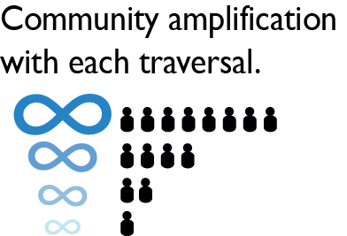
1. Determine Community Priorities
5.Investigate and Refine
2. Identify Barriers and Potential Solutions
4. Implement
Amplify
Develop
7. Test and Refine
6. Publish
3. Design
Open Community Engagement Process
(OCEP)
Notes:
To achieve the goals of WSSI, we have developed a model that brings together scientists and software engineers to work collaboratively on research and developing software to support scientific research.
This model is called “The Open Community Engagement Process.” It combines Agile development principles with an open source approach. Scientists and software engineers traverse these 7 steps in OCEP, iterating and repeating steps as needed to achieve maximum result.
Let me explain this diagram further…
***PLEASE NOTE: This diagram has been revised since the paper. It continues to be revised as we learn more about what works and what doesn’t with this process.
[1 min]

Slide 12
RHESSys
A prototypical traversal of steps 1 - 5.
Two iterations of the Implement step—two hackathons.
RHESSys code has been enhanced, calculation time of the CF9 functionality has been reduced!
CASE STUDIES
GI Venture
Plans to traverse all steps within OCEP.
Currently on working on step 4 (Implement) and step 6 (Publish)
Notes:
Briefly define RHESSys and the GI Venture and its goals.
The next slides will focus on the GI Venture: accomplishments and challenges.
[1 min]

Slide 13
Accomplishments
We have been able to engage this group in:
Determining priorities in the current landscape of GI research and implementation,
Finding common ground, sharing expertise and knowledge,
Creating a set of research questions that we, as a group, will pursue,
And most importantly, we have been able to engage scientists in generating software requirements in the form of personas and scenarios. Spend time discussing personas and scenarios, particularly how they are palatable ways for scientists to write requirements (they are non-threatening, writing in plan English, and do not require coding skills).
Our next meeting in September, we will present a prototype to a group of stormwater engineers.
GI VENTURE
Notes:
We have been able to engage this group in:
Determining priorities in the current landscape of GI research and implementation
Finding common ground, sharing expertise and knowledge
Creating a set of research questions that we, as a group, will pursue
And most importantly, we have been able to engage scientists in generating software requirements in the form of personas and scenarios. Spend time discussing personas and scenarios, particularly how they are palatable ways for scientists to write requirements (they are non-threatening, writing in plan English, and do not require coding skills).
Our next meeting in September, we will present a prototype for a group of stormwater engineers.
[2-3 mins]

Slide 14
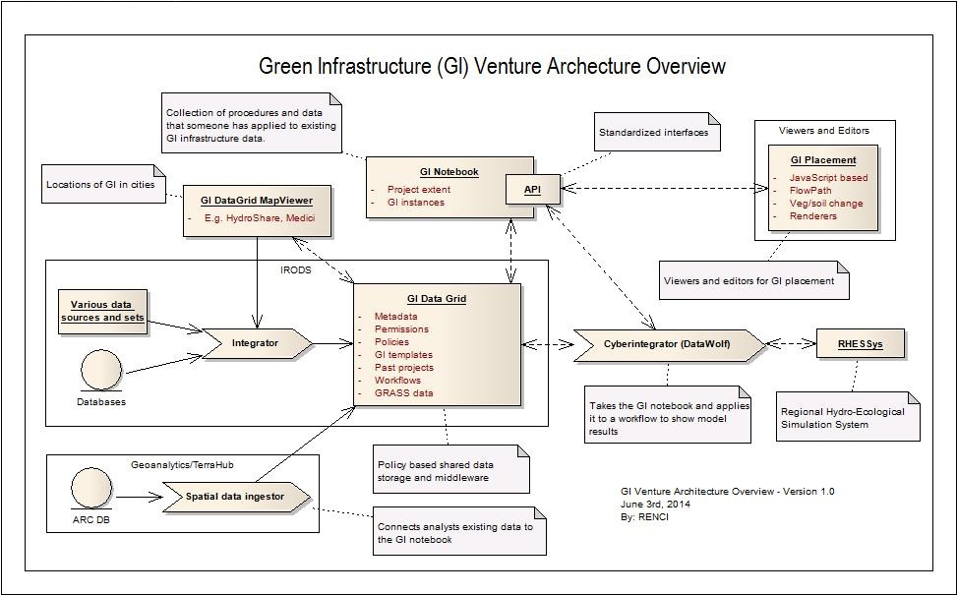
Proposed Architecture
Notes:
This architecture will allow users to modify GI and view the effects, in 3D, on top of Google Street View (Viewers and Editors in the diagram—building those ourselves). The rest of the system takes care of finding existing GI and drainage models (i.e., RHESSys) to work off of, modify those models with the edits that users make to the GI. Models can be run on an HPC system (i.e., CyberIntegrater/Datawolf). Model results can be saved in HydroShare and iRODS. Then changes that were made to models and who made those changes is recorded. Thus we have provenance recorded for the work being done by scientists.
The GI that is designed through this system can be assessed in terms of whether it satisfies local regulations and needs.
Data can be exported to ArcGIS or AutoCAD via GeoAnalytics/TerraHub.

Slide 15
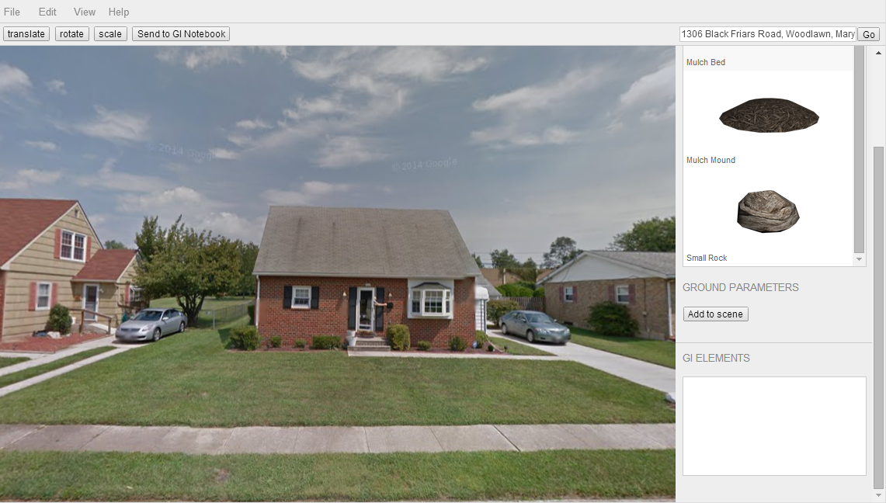
Blank View: Before Placing GI
http://cybersees.github.io/gi-studio/editor/
Notes:
This image shows the default Google street view image without any added green infrastructure elements. Green infrastructure objects that can be placed in the scene are shown in the right sidebar.

Slide 16
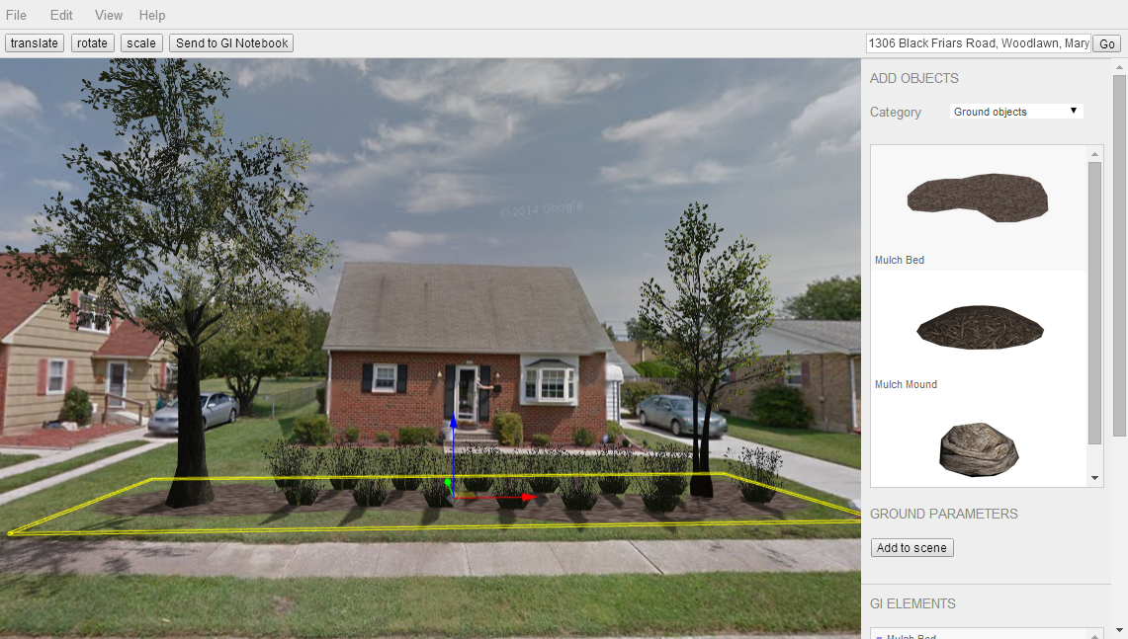
Selection of a Ground Object
Notes:
This image shows a composite green infrastructure element (a rain garden). Composite elements are made up of many independent objects (mulch bed, trees, grasses, shrubs). Each object in the scene can be selected and repositioned, resized, and rotated. Selection is indicated by the yellow outline and manipulation is performed via the colored arrows.

Slide 17
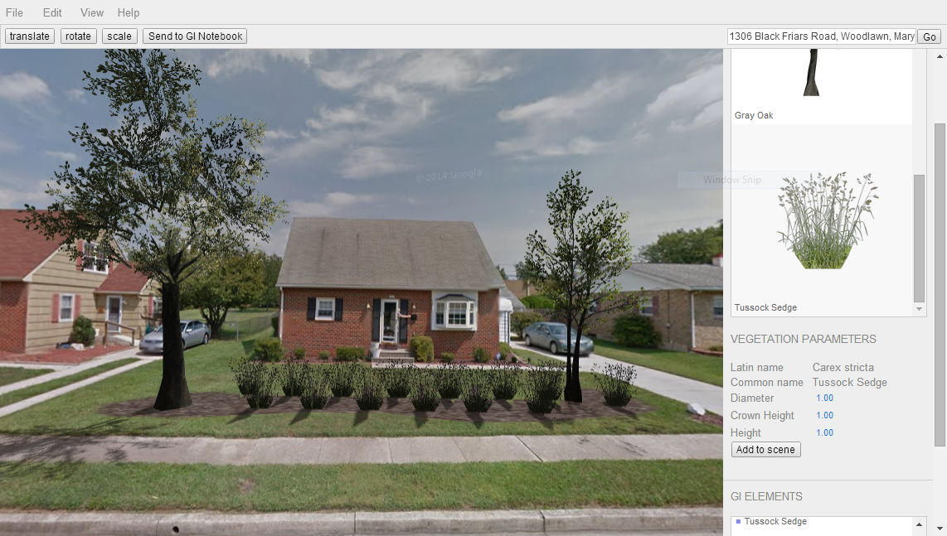
Placement of a Rain Garden
Notes:
The final visual result. Note the RHESSYS vegetation parameters in the right sidebar.

Slide 18
Big Challenges: Establishing Mutual Understanding
Communication is key. Bringing together water scientists, urban planners, stormwater engineers, social scientists, computer scientists, and software engineers means that substantial time has been and will continue to be required to:
Share expertise and vocabulary
Translate domain knowledge
Negotiate ideas and needs
Clarify approaches to work
Etc.
This takes time, energy, and commitment from all involved.
Terms have to be defined. E.g.,
publish
model
GI VENTURE
Notes:
Communication is key. Bringing together water scientists, urban planners, stormwater engineers, social scientists, computer scientists, and software engineers means that substantial time has been and will continue to be required to:
Share expertise and vocabulary
Translate domain knowledge
Negotiate ideas and needs
Clarify approaches to work
Etc.
This takes time, energy, and commitment from all involved.
Terms have to be defined. For example, publish to scientists means publishing papers and posters. Publish to software engineers means to publish code/software.
Model to water scientists refers to a simulation—of sorts—that demonstrates how certain environmental parameters may combine and interact. Model to software engineers refers to a diagram that documents software system design specifications.

Slide 19
Big Challenges: Establishing Mutual Understanding cont.
Connecting RQs to software can be tough for both scientists and software folks.
How do RQs relate to software?
How do RQs motivate software design?
What helps?
Personas – characterizations of potential system users such as the scientists
Scenarios – stories about system use, how those personas or scientists would use the software to answer the questions.
Personas and scenarios are
easy to understand and write,
do not require coding skills, and
can serve as boundary objects to facilitate communication around the subject of RQs and system requirements.
They help bring together these ideas in a plain English way that is understandable by all.
GI VENTURE
Notes:
Connecting RQs to software can be tough for both scientists and software folks. Scientists understand the RQs but may have trouble envisioning how those RQs relate to the software. Tech folks understand software but may have trouble backing up to the RQs that should motivate software design.
Essentially, the software should enable the scientists to answer the RQs. One way that we have found that helps all parties understand is to create personas (of potential system users such as the scientists) and scenarios (stories about system use, how those personas or scientists would use the software to answer the questions). As I mentioned earlier personas and scenarios are easy to understand and write, do not require coding skills, and can serve as boundary objects to facilitate communication around the subject of RQs and system requirements. They help bring together these ideas in a plain English way that is understandable by all.

Slide 20
Big Challenges: Segregation or Integration?
Current philosophy
The current OCEP model suggests that the two groups (scientists and software folk) are not to be segregated, that they will perform both the research and the software development together as a unified group.
GI VENTURE
Notes:
Current philosophy: The current OCEP model suggests that the two groups (scientists and software folk) are not to be segregated, that they will perform both the research and the software development together as a unified group.

Slide 21
Big Challenges: Segregation or Integration?
Challenges of integration
Scientists may not want to participate in technology-focused activities.
Coding may not be a skill they want to cultivate or need to cultivate to advance their career.
So they may opt out of activities if the activities are described as being technology-intensive.
However, these non-coding scientists—the ones we’ve worked with—expressed enjoyment with creating software requirements in the form of personas and scenarios; and they excelled at this activity.
GI VENTURE
Notes:
Challenges of integration:
Some scientists may not want to participate in more technology-focused activities. E.g., coding may not be a skill they want to cultivate or need to cultivate to advance their career or satisfy the demands of their job. For example, they may opt out of meetings if the meetings are described as being technology-intensive. However, these non-coding scientists—the ones we’ve worked with--expressed enjoyment with creating software requirements in the form of personas and scenarios; and they excelled at this activity.

Slide 22
Big Challenges: Segregation or Integration?
Benefits of integration
Integration encourages more information sharing and knowledge translation between different domains. This may make the work more creative because we are learning and pushing boundaries.
GI VENTURE
Notes:
Benefits of integration:
Not segregating has the benefits of encouraging more information sharing and knowledge translation between different domains; this may also make the work more creative. Reference Granovetter’s article The Strength of Weak Ties. Granovetter and the field of social network analysis suggest that when different people (different backgrounds, sources of knowledge, different experience, etc.) mix, they are more likely to expose each other to new and different information. We believe this also means that their work can be more innovative, more creative; because they are learning and pushing boundaries.

Slide 23
Big Challenges: Segregation or Integration?
Questions We’re Trying to Answer
What do we make of the paradox of scientists who do not want to focus on technology, yet say they enjoy some technologically-focused activities?
How do we keep non-coding scientists engaged?
Or should we only select coding scientists for WSSI/OCEP work?
Or should we revise OCEP so that some activities integrate the groups, and other activities (i.e., coding specifically) allow for segregation? Will this create problems for synthesis and mutual understanding?
What’s reasonable given current culture and given our desire to create a culture shift? How do we demonstrate respect and understanding for current culture, but also help the academic community gently ease into a cultural shift where sharing software/code and data are desired and factored into tenure/promotion and funding decisions?
GI VENTURE
Notes:
This leaves us at WSSI in a quandry:
What do we make of the paradox of scientists who do not want to focus on technology yet say they enjoy some technologically-focused activities?
How do we keep non-coding scientists engaged?
Or should we only select coding scientists for WSSI/OCEP work?
Or should we revise OCEP so that some activities integrate the groups, and other activities (i.e., coding specifically) allow for segregation? Or do we offer research and technical activities in parallel at all times? Will this create problems for synthesis and mutual understanding?
If we allow for segregation, are we really accomplishing the goals of WSSI and OCEP? Or do we need to rethink our philosophy, our vision?
What’s reasonable given current culture and given our desire to create a culture shift? How do we demonstrate respect and understanding for current culture, but also help the academic community gently ease into a cultural shift where sharing software/code and data are desired and factored into tenure/promotion and funding decisions?

Slide 24
Big Challenges: Sustaining Engagement
Our team members—particularly the academic researchers—are overloaded.
To obtain tenure and promotion, these faculty must publish, get grants, teach, advise students, and fulfill service obligations. At the current time, very few academic institutions value code enough to make it a part of tenure/promotion decisions. This means that we at WSSI are constantly competing with these priorities.
Incentives?
Publications
Funding
GI VENTURE
Notes:
The GI Venture is a multi-year project. Our team members—particularly the academic researchers—are overloaded already. To obtain tenure and promotion, these faculty must publish, get grants, teach, advise students, and fulfill service obligations. As you know, this leaves little time for activities that may not be directly used in tenure/promotion decisions (which, currently, sharing software/code and data are not in most cases). Faculty must prioritize their overflowing agendas and engineer them so as to advance in a culture that primarily values publications and grants. At the current time, very few academic institutions value code enough to make it a part of tenure/promotion decisions. This means that we at WSSI are constantly competing with these priorities.
We are strategizing about how to sustain the engagement of our academic team over the course of this project with the understanding that other priorities may push WSSI project needs aside. Part of our strategizing is to offer incentives that speak to these tenure/promotion decisions. For example, at our last GI Venture meeting, we set aside time to discuss publications that could come quickly from the work we are doing currently. These publications lay out our current research goals, and our intentions to accomplish those goals and resolve problems in the current state of affairs in GI. Later we can also publish papers on our findings, when the software has been built and scientists are able to use it to test hypotheses.
We are also investigating other forms of incentives: funding, bringing students on board, writing smaller grant proposals that can be tacked on to our current work. But with each of these, there are challenges. For example, our current funding doesn’t provide room to offer extra funding to our participants or to fund their students. In the future, we will need to develop a model for more incentives and factor that into grant proposals.
We are interested in your feedback on this problem…?

